Slide 1
MINOR PROJECT Presentation
CATAPULT GAME IN C#
MENTOR:
Prof. Shalini Chawla
Presented By :
Gurpreet Singh Matharu (08311503109)
Pradeep Budhwar (08511503109)
Mohit Gupta (08811503109)
Nitin Jaiswal (0301153108)

Slide 2
PREREQUISITES
Microsoft Visual Studio 2010 Ultimate
Microsoft Visual Studio Service Pack 1
Microsoft Windows 7 Ultimate
Microsoft Windows Phone 7.1 SDK
Microsoft Windows Phone Emulator
Adobe Photoshop CS 5
FL Studio

Slide 3
Setting up the Environment 1) Install Microsoft Visual Studio 2010
Microsoft Visual Studio is an integrated development environment (IDE) from Microsoft.
It is an editor.
It can support various coding languages like .NET, C++, C#, etc
It can be used to develop console and graphical user interface applications like Windows Phone applications, web sites, web applications, and web services.
It includes new modeling tools, such as the Architecture Explorer, which graphically displays projects and classes

Slide 4
2) Microsoft Visual Studio Service Pack 1
This download installs Visual Studio 2010 Service Pack 1 (SP1). This service pack release addresses issues that were found through a combination of customer and partner feedback, as well as internal testing.
These service packs offer Visual Studio users improvements in responsiveness and stability, as well as completes some high-impact scenarios requested by customers.

Slide 5
3) Microsoft Windows Phone 7.1 SDK
The Windows Phone Software Development Kit (SDK) 7.1 provides you with all of the tools that you need to develop applications and games for both Windows Phone 7.0 and Windows Phone 7.5 devices.
The Windows Phone SDK includes the following
Microsoft Visual Studio 2010 Express for Windows Phone
Windows Phone Emulator
Windows Phone SDK 7.1 Extensions for XNA Game Studio 4.0

Slide 6
4) Microsoft Windows Phone Emulator
EMULATOR IS REQUIRED TO DISPLAY THE OUTPUT ON A VIRTUAL WINDOWS PHONE DEVICE.
SYSTEM REQUIREMENT
WINDOWS 7 ULTIMATE VERSION
Microsoft Visual Studio 2010 Service Pack 1
DISK SPACE UPTO 20 GB
RAM 3 GB

Slide 7
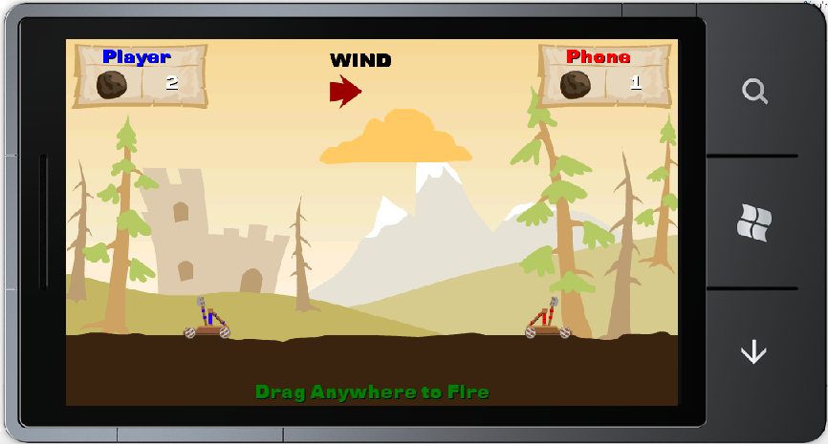
Game Description
1) Our game is a 1-Player game.
2) Both ,user and phone are represented by a catapult.
3) Each successful hit would earn the catapult one point.
4) Catapult has to successfully hit the enemy catapult 5 times to win the game.
5) Game is COMPATIBLE with Windows Phone 7.1

Slide 8
States of a Game
A game usually has three states:
Loading – In this state, the system loads resources, initializes game-related variables, and performs any other tasks that have to be performed before the game actually begins. This state typically occurs only once in the game’s life cycle. More complicated games may divide loading among the levels or stages of a game as the user progresses.
Update – In this state, the system needs to update the game-world state. Usually this means calculating new positions of the acting entities, updating their positions and actions, recalculating the score, and performing other game logic as is relevant to the game. These updates occur regularly throughout the game play.
Draw – In this state, the system draws the changes, calculated in the update state, to the output graphics device. Drawing occurs regularly throughout the game play.

Slide 9
Screens included in our Game
The game includes the following screens:
Home screen (Background class)
Main menu (MainMenuScreen class)
Instructions screen (InstructionScreen class)
GameplayScreen (GameplayScreen class)
Pause Screen (PauseScreen class)

Slide 10
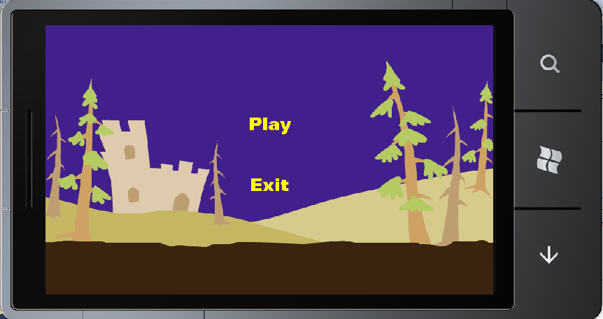
Main Menu Screen

Slide 11
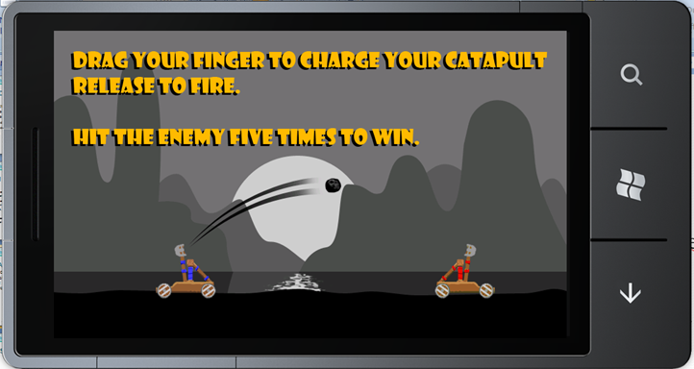
Instruction Screen

Slide 12
Game Play Screen

Slide 13

Pause Screen

Slide 14
GameplayScreen & Game Classes
Technically, the game’s update and drawing logic is contained in the GameplayScreen class. However, the GameplayScreen itself will not directly handle all of the work, as some of it is the responsibly of the relevant game classes.
Let us review some of the game classes and their intended purpose:
Player: The player class represents one of the two players participating in the game and is responsible for drawing its associated catapult on the screen.
Two different sub-classes of the Player class actually represent each of the players. The Human class represents the human player and contains additional logic for handling user input and providing visual feedback to the user, while the AI class represents the computer player and contains additional logic for automatically aiming and firing at the human player.

Slide 15
Catapult: The catapult class encapsulates all the drawing and logic related to one of the catapults in the game. The class keeps track of its associated catapult’s state and animates it according to that state.
Projectile: This class represents a projectile fired by one of the catapults. It is responsible for rendering the projectile and updating its position, but not for determining whether or not the projectile has hit anything, as this is the job of the Catapult class.
Animation: It is a helper class for displaying animations.
AudioManager: It is a helper class for playing sounds.

Slide 16
Stages of Game Development
Basic game rendering
Game logic
Polishing the game – Sounds
Additional screens and menus

Slide 18
Adobe Photoshop CS5
Adobe Photoshop is a graphics editing program developed and published by Adobe Systems.
Adobe Photoshop CS5 is the 12th major release of Adobe Photoshop.
The CS rebranding also resulted in Adobe offering numerous software packages containing multiple Adobe programs for a reduced price.
Upon loading Photoshop, a sidebar with a variety of tools with multiple image-editing functions appears to the left of the screen. These tools typically fall under the categories of cropping and slicing; drawing; painting; measuring and navigation; selection; typing; and retouching.

Slide 19





Textures
Cloud
Catapult
Lose
HUD(Heads-Up Display)
Win

Slide 20
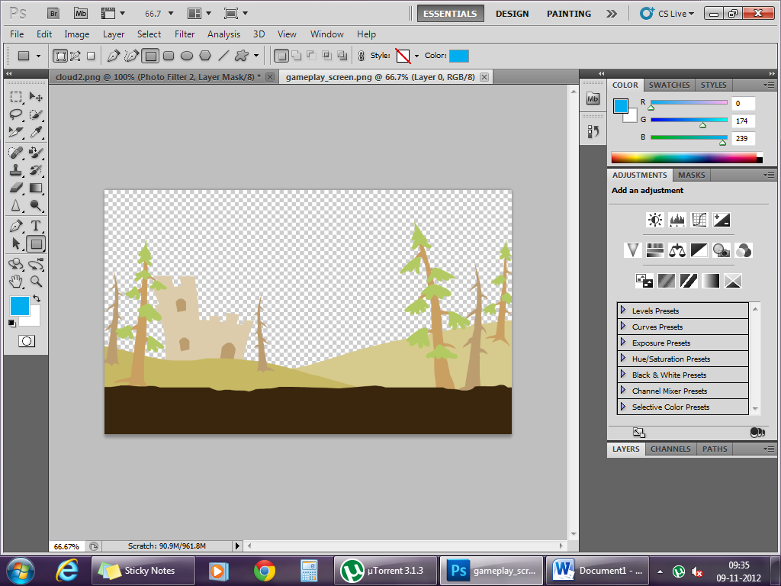
Background Texture

Slide 21
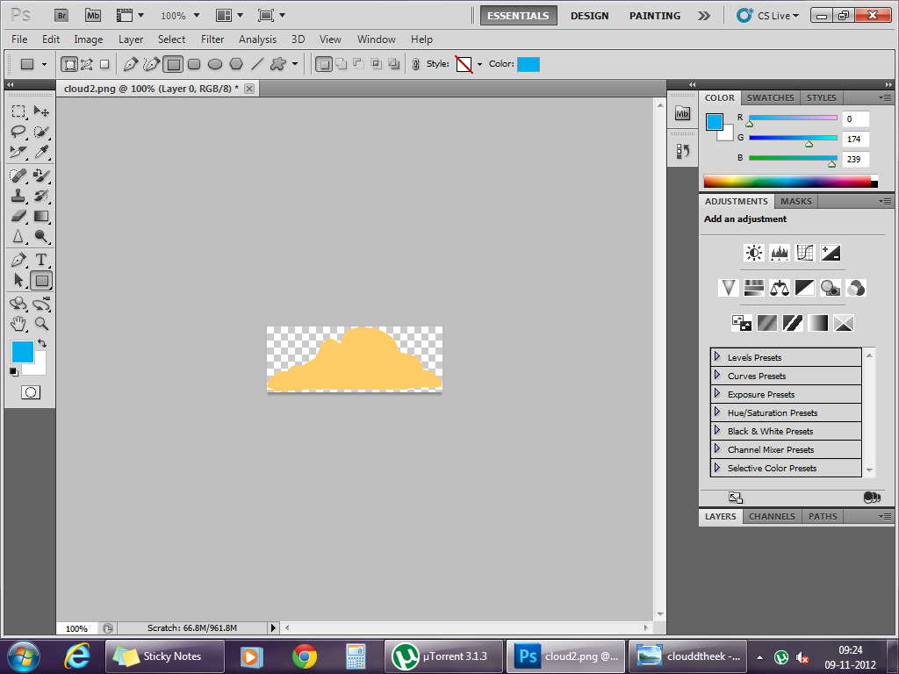
Snapshot

Slide 22
Adjustments
Color -- RGB components can be specified
Swatches -- All colors can be picked and used through a pen
Styles -- Environments can be applied
Levels Presets -- Contrast,brightness,etc
Black and White Presets --
Curves Presets -- RGB components can be changed through a graphical representation

Slide 23
SOUNDS
BoulderHit
CatapultExplosion
CatapultFire
Lose
RopeStretch
Win

Slide 24
WHAT WE LEARNED…….
An understanding of the XNA Game Studio application model within the Windows Phone 7 operating system
Learned how to use resources (images, sounds, etc.) in our game
Learned how to add game logic
Learned how to use touch and gesture input to control our game

Slide 25
FUTURE PROSPECTS
More game stages/levels can be added
2 player game
Difficulty level can be increased
Background music can be added
More weapons besides stone
User can set winning criterion

Slide 26
REFERENCES
[1] Guidance & immense support by GURMEET SINGH
[2] Guidance by TARANJEET SINGH,Google India
[3] http://www.freewebs.com/campelmxna/tutorials.htm
[4] http://www.dreamincode.net/forums/topic/99860-creating-games-in-c%23-part-i/
[5] http://kat.ph/
[6] http://en.wikipedia.org/wiki/Microsoft_Visual_Studio
[7] http://en.wikipedia.org/wiki/Adobe_Photoshop

Slide 27
THANK
YOU

